Slide 1
Variant detection and Annotation workshop
Nizar Drou & Manikandan Vinu
26th-27th Feb 2024

Slide 2
Nutshell
RECAP : Pipeline Workflow
File Formats
Why Annotating
Intend of annotation
Tools to annotate
Understanding the output
Filtering the VCF
Visualization of the output

Slide 3
RECAP : Pipeline Workflow

Slide 4
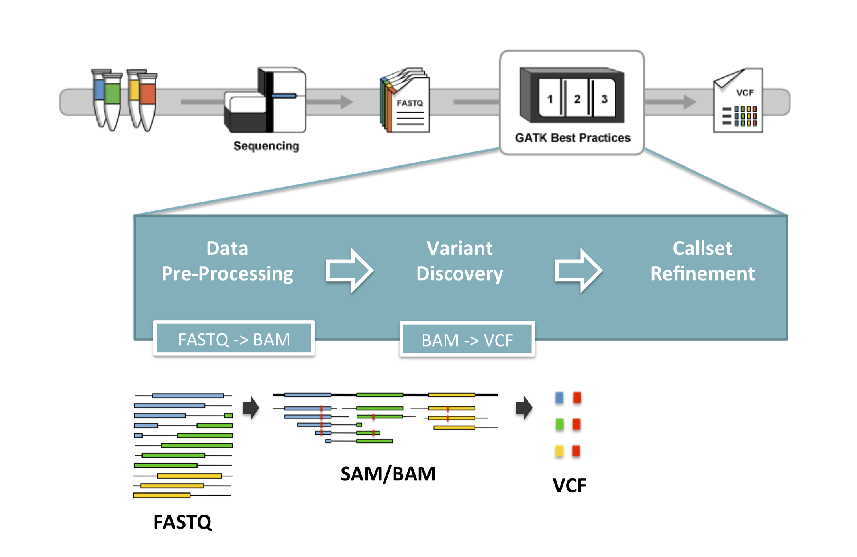
Workflow: Overview
Source: gatk talks

Slide 5
Basic Workflow
Tools Used
Raw Fastq File(s)
Output files
Fastqc, Trimmomatic
Preprocessing Reads
trimmed fastq
BWA/Bowtie2
Mapping to Reference genome
sam/bam files
samtools/picard/gatk
Mapping post processing
clean bam
gatk/freebayes/samtools
Variant calling
VCF
gatk/wAnnovar/VEP/SnpEff
Variant filtering and Annotation
annotated VCF
igv
Visualization

Slide 6
File Formats

Slide 7
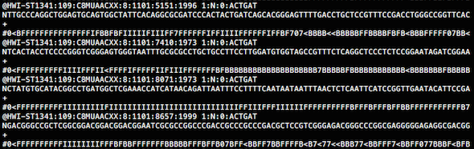
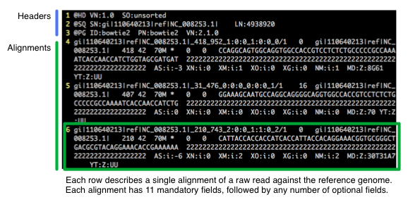
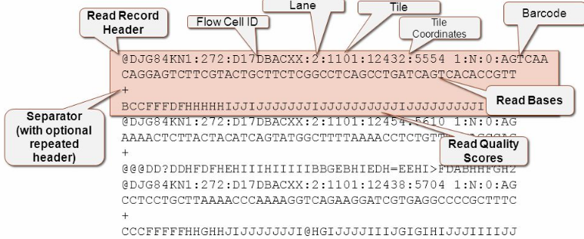
Standard output formats
Fastq format
SAM/BAM format

Slide 8
VCF File Format
- Standard file format within field of genetics/genomics
- Output file generated by almost all variant calling software
- File format used in downstream tools for data analysis
File and Genome Information

Slide 9
VCF File Format
Field Descriptions

Slide 10
VCF File Format
Genetic Variation
http://samtools.github.io/hts-specs/VCFv4.3.pdf

Slide 11
VCF File Format
Main Fields:
CHROM: Chromosome within reference genome
POS: Position within Chromosome (or contig)
ID: Identifier – most often rs number from dbSNP
REF: Reference base(s) – can be multiple for insertion/deletion
ALT: Alternate base(s) – can include multiple alternate bases
QUAL: Quality – phred based probability that alternate base(s) is wrong
FILTER: Filter – PASS or reason for fail based on filter criteria
INFO: Additional information – details normally in metadata
FORMAT: Information detailing data types displayed
SNP DATA: Normally genotype plus other data types

Slide 12
VCF File Format
0->Ref 1->1st Alt 2->2nd Alt N->N^{th} Alt
G/G
A/G
A/A
Hom-REF
Het
Hom-Alt
Chr 20
Pos 14370
Reference G
Alternative A
Pass
Variant Info:
3 samples
14 reads total
Allele Freq = 50%
Variant In dbSNP
Variant in Hapmap2
Info:
Genotype = Heterozygote
Quality = 48
Read Depth = 8
Haplotype Quality = 51&51
Expect Info on:
Genotype
Quality
Read Depth
Haplotype Quality
rs6054257
Variant Quality 29

Slide 13
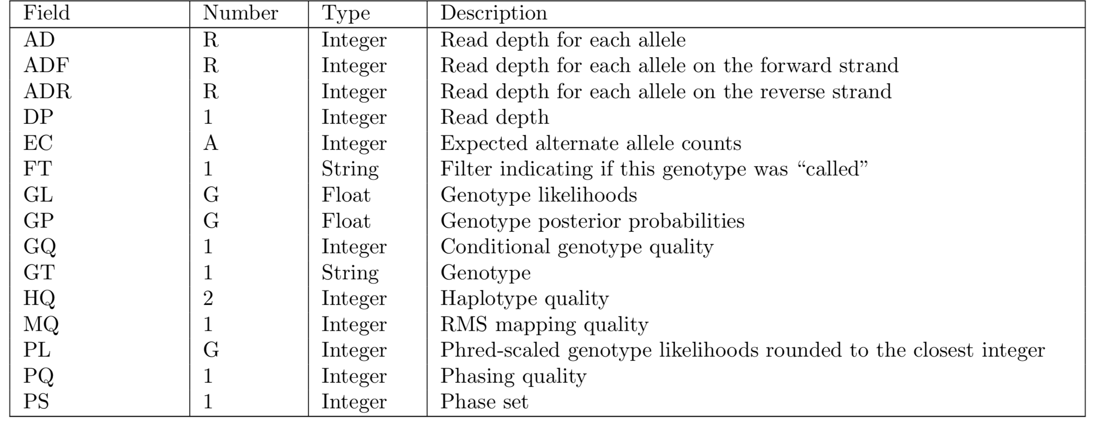
VCF File Format
Other genotype keys

Slide 14
VCF vs gVCF
GVCF is an extension of the VCF format for use in joint genotyping or variant calling across multiple samples (-ERC: GVCF and BP_RESOLUTION)
Instead of containing only variant calls, it includes sites where the genotype is homozygous reference.
They enable joint calling of variants across multiple samples, which can improve sensitivity for rare variants and help in identifying variants in regions with poor coverage and no Coverage.
Sam 1
Sam 2
Sam 3
chr7 115013011 A G 1/1 ./. 0/1
chr7 44041729 . T <NON_REF> . . END=44041731 GT:DP:GQ:MIN_DP:PL 0/0:1:3:1:0,3,28

Slide 15
Why Annotating ?

Slide 16
Variant Annotation
Explore VCF file generated from a sequence of a patient
Which mutations could be important to understand disease?
Perform Variant Annotation

Slide 17
Variant Annotation
What type of information might we be interested in?
Functional annotation: where is the variant located and what type of change does it cause: missense, nonsense, intronic, intergenic.
Frequency Information: how common is the mutation in the general population? 1000 Genomes data, EXac data.
Evolutionary Conservation: Is position of the mutated site important? e.g. GERP score
Gene Information: if exonic variant, which gene is it in?
Predicted impact: do we know anything about how the mutation might influence the protein structure? Polyphen, SIFT.
Association information: does the mutation influence the expression of a gene, or been previously associated with a disease?

Slide 18







Tools for VCF Annotation
http://wannovar.wglab.org
https://asia.ensembl.org/Tools/VEP
http://snpeff.sourceforge.net
http://snpeff.sourceforge.net/SnpSift.html
https://snp.gs.washington.edu/SeattleSeqAnnotation151/
https://www.qiagenbioinformatics.com/products/ingenuity-variant-analysis/
Ingenuity Variant Analysis
http://www.diploid.com/moon
https://franklin.genoox.com/home

Slide 19
VCF Annotation: snpEff & snpSift
SnpEff is a variant annotation and effect prediction tool. It annotates and predicts the effects of genetic variants
(such as amino acid changes)
Add loss of function (LOF) and Nonsense mediated decay
(NMD) tags
snpEff -Xmx80g eff -nodownload -csvStats p1.stats.csv -o vcf -s p1.summary.html -lof GRCh38.105 p1.g.vcf.gz > p1.snpEff.g.vcf
Summary Outputs
Database
Input
ouputput
http://pcingola.github.io/SnpEff/snpeff/commandline/

Slide 20
VCF Annotation: snpEff & snpSift
3 Outputs : p1.summary.html summary.genes.txt stats.csv
summary/stats : gives the summary of the variants and annotations
summary.genes.txt : gives variants annotation per Gene/transcript per annotation

Slide 21
VCF Annotation: snpEff & snpSift
Output from gatk
chr7 115013011 . A G,<NON_REF> 37.31 . DP=2;ExcessHet=0.0000;MLEAC=1,0;MLEAF=0.500,0.00;RAW_MQandDP=7200,2 GT:AD:DP:GQ:PL:SB 1/1:0,2,0:2:6:49,6,0,49,6,49:0,0,1,1
Output from snpEff
chr7 115013011 . A G,<NON_REF> 37.31 . DP=2;ExcessHet=0.0000;MLEAC=1,0;MLEAF=0.500,0.00;RAW_MQandDP=7200,2;ANN=G|intron_variant|MODIFIER|MDFIC|ENSG00000135272|transcript|ENST00000393486.6|protein_coding|4/4|c.494-2677A>G||||||,G|intron_variant|MODIFIER|MDFIC|ENSG00000135272|transcript|ENST00000498196.1|protein_coding|3/3|c.329-2677A>G||||||WARNING_TRANSCRIPT_INCOMPLETE,G|intron_variant|MODIFIER|MDFIC|ENSG00000135272|transcript|ENST00000431629.5|nonsense_mediated_decay|3/4|n.464-1452A>G|||||| GT:AD:DP:GQ:PL:SB 1/1:0,2,0:2:6:49,6,0,49,6,49:0,0,1,1
Added More information such as Gene, Transcript, Variant type and locations

Slide 22
VCF Annotation: snpEff & snpSift
ANN=G|intron_variant|MODIFIER|MDFIC|ENSG00000135272|transcript|ENST00000393486.6|protein_coding|4/4|c.494-2677A>G||||||,
G|intron_variant|MODIFIER|MDFIC|ENSG00000135272|transcript|ENST00000498196.1|protein_coding|3/3|c.329-2677A>G||||||WARNING_TRANSCRIPT_INCOMPLETE,
G|intron_variant|MODIFIER|MDFIC|ENSG00000135272|transcript|ENST00000431629.5|nonsense_mediated_decay|3/4|n.464-1452A>G||||||
GT:AD:DP:GQ:PL:SB 1/1:0,2,0:2:6:49,6,0,49,6,49:0,0,1,1
Description:
Effect
GeneName & ID
FeatureID
Exon/Intron # / # Tnum exons/introns
G|intron_variant|MODIFIER|MDFIC|ENSG00000135272|transcript|ENST00000393486.6|protein_coding|4/4|c.494-2677A>G||||||,
Allele
putative impact /
deleteriousness
Feature type
Biotype

Slide 23
VCF Annotation: snpEff & snpSift
SnpSift is a toolbox that allows you to filter and manipulate annotated files.
SnpSift annotate -tabix GRCh38.105/clinvar.vcf.gz p1.snpEff.g.vcf > p1.snpEff.clinvar.g.vcf
SnpSift annotate -tabix GRCh38.105/Homo_sapiens_assembly38.dbsnp138.vcf.gz -dbsnp p1.snpEff.clinvar.g.vcf > p1.snpEff.clinvar.dbsnp.g.vcf
chr7 117735320 rs62617115 A C,<NON_REF> 323.64 . BaseQRankSum=1.497;DB;DP=24;ExcessHet=0.0000;MLEAC=1,0;MLEAF=0.500,0.00;MQRankSum=0.000;RAW_MQandDP=86400,24;ReadPosRankSum=0.352;ANN=C|missense_variant|MODERATE|CTTNBP2|ENSG00000077063|transcript|ENST00000160373.8|protein_coding|15/23|c.3637T>G|p.Leu1213Val|3663/5904|3637/4992|1213/1663||,C|missense_variant|MODERATE|CTTNBP2|ENSG00000077063|transcript|ENST00000446636.5|protein_coding|13/21|c.2098T>G|p.Leu700Val|2099/4250|2098/3453|700/1150||WARNING_TRANSCRIPT_NO_START_CODON,C|3_prime_UTR_variant|MODIFIER|CTTNBP2|ENSG00000077063|transcript|ENST00000441556.5|nonsense_mediated_decay|15/23|n.*1551T>G|||||49117|,C|downstream_gene_variant|MODIFIER|CTTNBP2|ENSG00000077063|transcript|ENST00000435233.5|protein_coding||c.*11T>G|||||11|WARNING_TRANSCRIPT_INCOMPLETE,C|non_coding_transcript_exon_variant|MODIFIER|CTTNBP2|ENSG00000077063|transcript|ENST00000441556.5|nonsense_mediated_decay|15/23|n.*1551T>G||||||;CAF=[0.9784,0.02158];COMMON=1;HD;KGPROD;KGPhase1;OTHERKG;RS=62617115;RSPOS=117375374;SAO=0;SSR=0;VC=SNV;VLD;VP=0x050000000001140416000100;WGT=1;dbSNPBuildID=129 GT:AD:DP:GQ:PL:SB 0/1:10,14,0:24:99:331,0,193,361,235,597:5,5,5,9

Slide 24
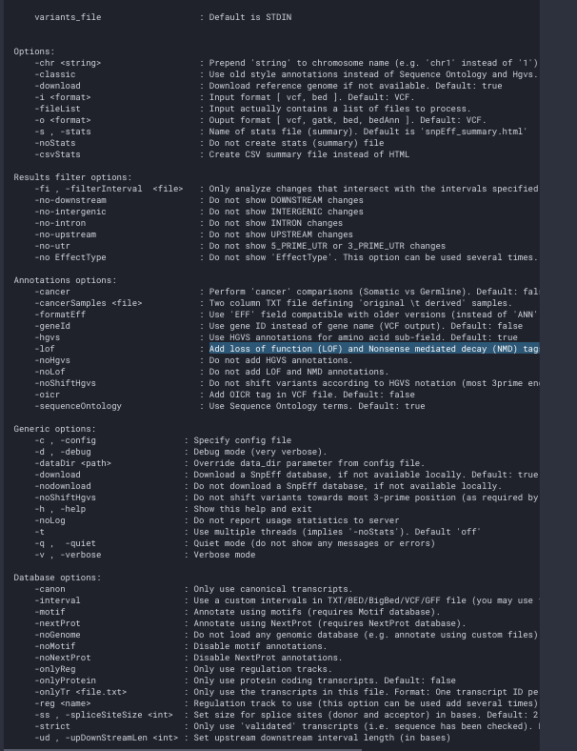
VCF Annotation: snpEff & snpSift
choose options appropriately

Slide 25
Filtering VCF

Slide 26
Basic Criterias
Depth: Minimum depth cutoffs will remove false positive calls and will ensure higher quality calls too.
Quality Genotype quality is also an important filter - essentially you should not trust any genotype with a Phred score below 20 which suggests a less than 99% accuracy.
Minor allele frequency MAF can cause big problems with SNP calls - and also inflate statistical estimates downstream. Ideally you want an idea of the distribution of your allelic frequencies but 0.05 to 0.10 is a reasonable cut-off. You should keep in mind however that some analyses, particularly demographic inference can be biased by MAF thresholds.
Missing data How much missing data are you willing to tolerate? It will depend on the study but typically any site with >25% missing data should be dropped.

Slide 27
Tools for VCF Filtering
VCFtools : https://vcftools.github.io
gatk VariantFiltration: https://gatk.broadinstitute.org/hc/en-us/articles/360037434691-VariantFiltration
SnpSift filter : https://pcingola.github.io/SnpEff/snpsift/filter/

Slide 28
VCF Filtering: snpsift
SnpSift filter is one of the most useful SnpSift commands.
Using SnpSift filter you can filter VCF files using arbitrary expressions, for instance
"(QUAL > 30) | ( countHet() > 2 )".
cat p3.snpEff.clinvar.dbsnp.g.vcf | SnpSift filter "(DP >= 20)) | (QUAL >= 30 ) " > snpsift_filtered.vcf
Read More :
https://pcingola.github.io/SnpEff/snpsift/filter/

Slide 29
VCF Filtering: VCFtools
module purge
module load all gencore/2
vcftools --gzvcf p3.snpEff.clinvar.dbsnp.g.vcf --minDP 20 --minQ 30 --recode-INFO-all --recode --stdout > vcftools_filtered.vcf
VCF Filtering: gatk
gatk -T SelectVariants -R ref -V raw_variants.vcf -selectType SNP -o snps.vcf
gatk -T VariantFiltration -R ref -V snps.vcf --filterExpression ' QUAL >= 30.0 ' --filterName "basic_snp_filter" -o filtered_snps.vcf

Slide 30
Visualization of the output

Slide 31
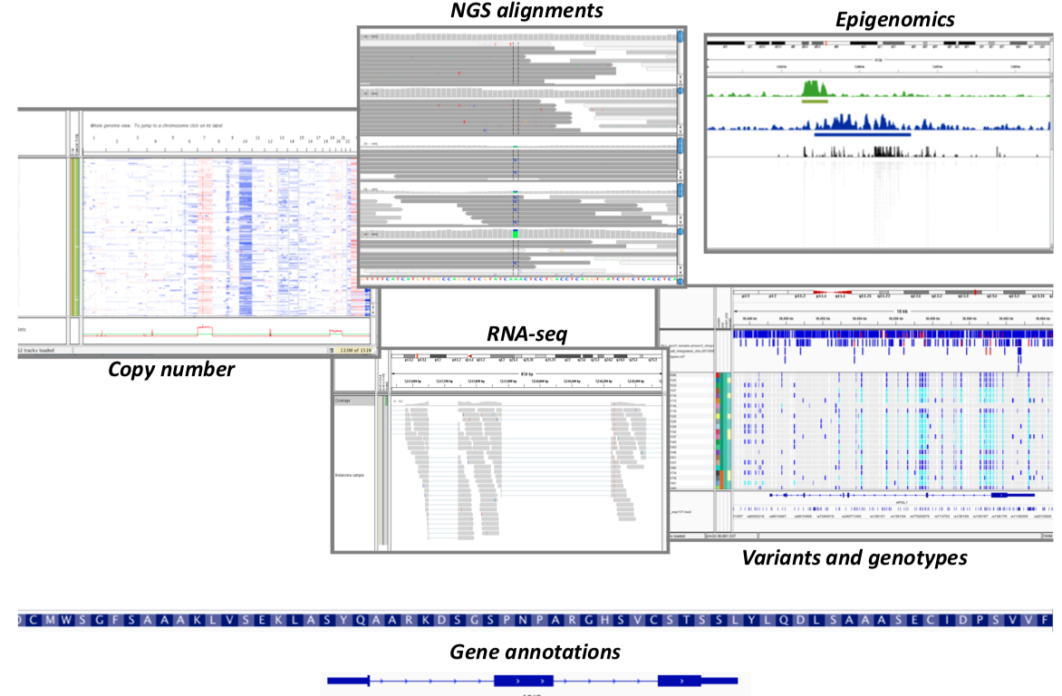
Integrative Genomics Viewer (IGV)
The Integrative Genomics Viewer (IGV) is a high-performance visualization tool for interactive exploration of large, integrated genomic datasets of different types
BroadE Workshop, April 2017

Slide 32
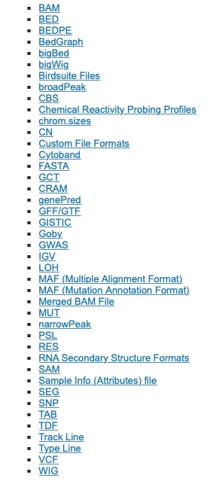
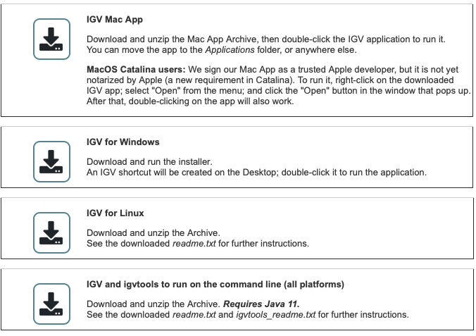
Integrative Genomics Viewer (IGV)
File Formats
Download & install
http://software.broadinstitute.org/software/igv/download

Slide 33
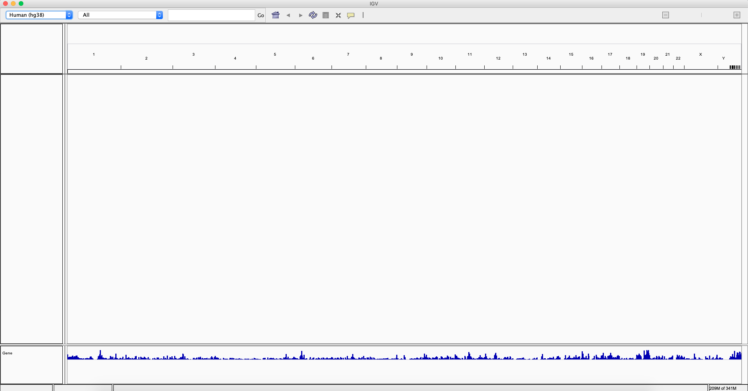
\{
Integrative Genomics Viewer (IGV)
Chromosome Selection
Reference Genome Selection
Enter locus/gene name
Zoom in/out
{
Whole Genome

Slide 34
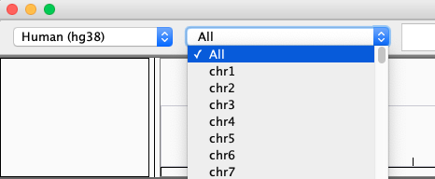
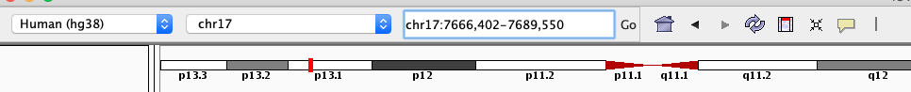
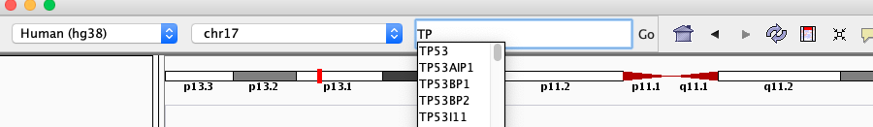
\{
IGV Basic panels: Chromosome Selection
Shows all the chromosome of the selected reference genome
IGV Basic panels: Locus/gene name
Chromosome:Start-end
Enter Gene Name

Slide 35
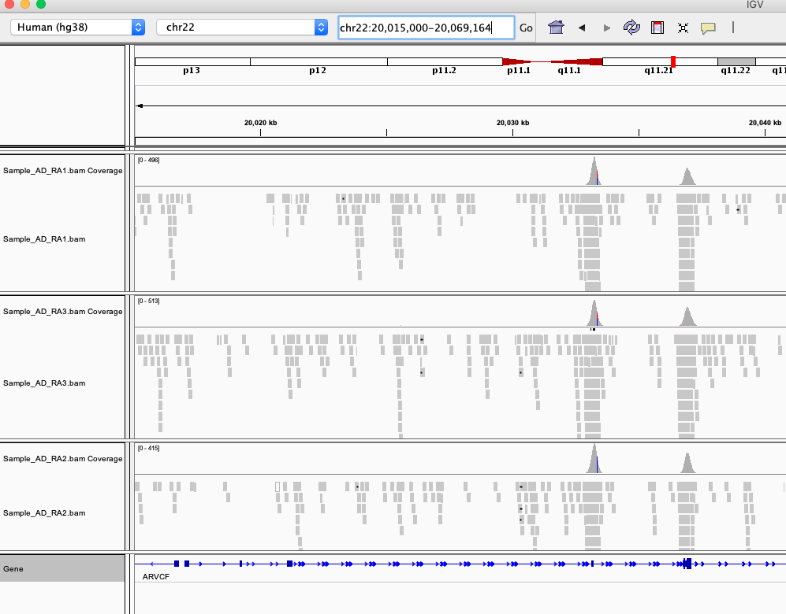
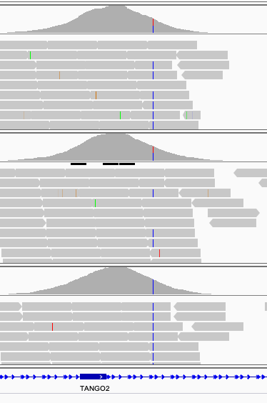
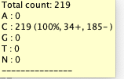
\{
IGV: View Gene of interest
Reference Genome Selection
Chromosome Selection
Coverage
Aligned reads mapped to the location
Variation
BAM FILES

Slide 36
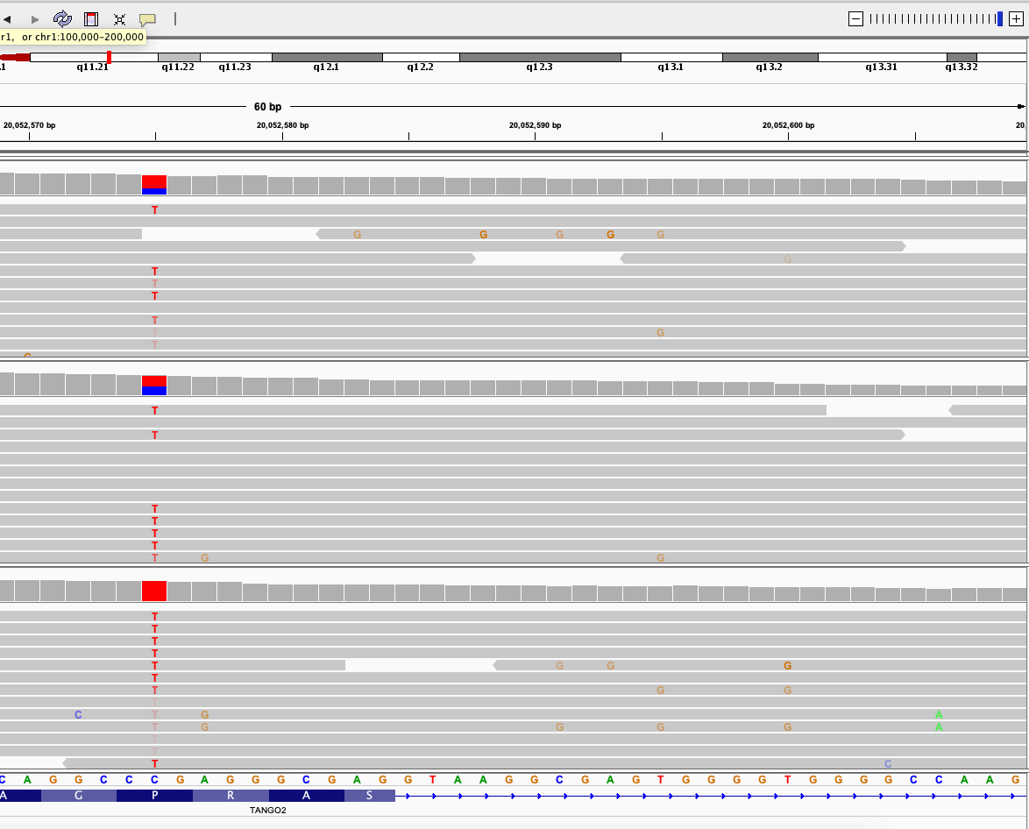

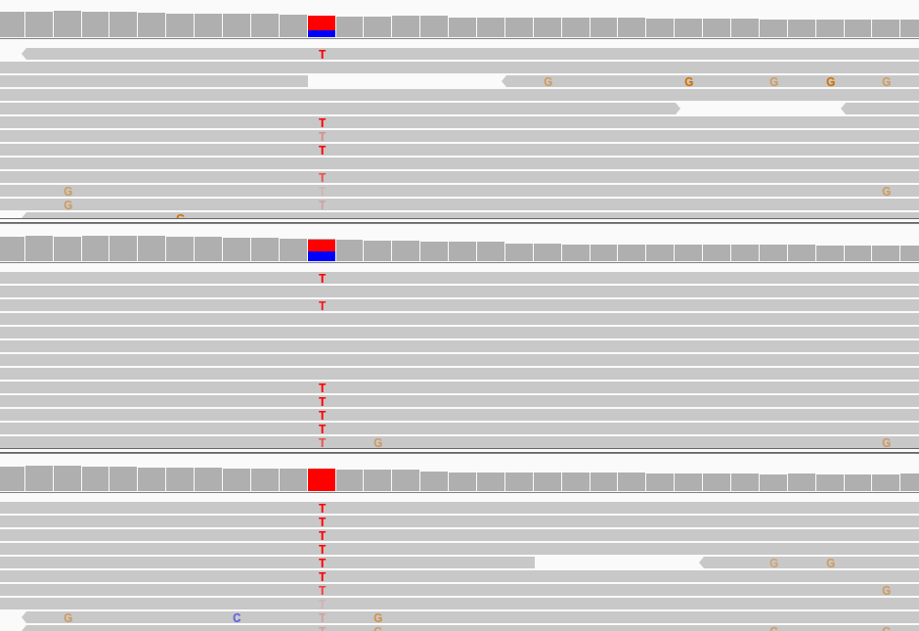
\{
IGV: Zoom
Zoom in/out
Click and Drag

Slide 37
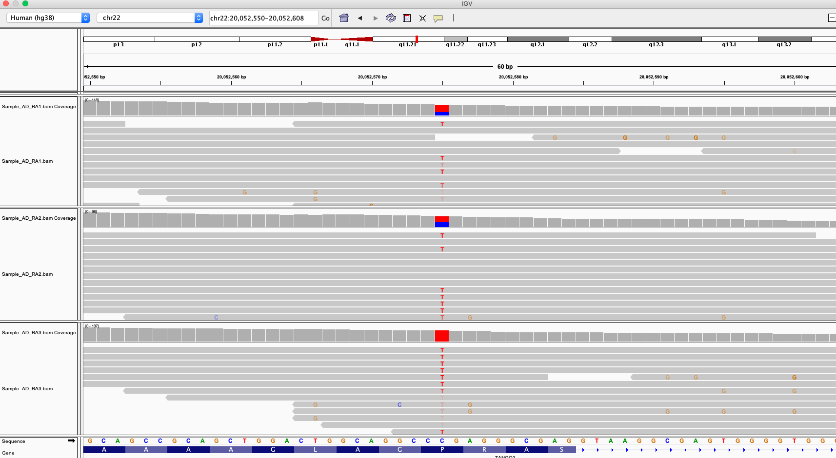
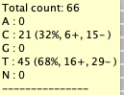
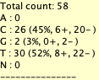
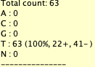
\{
IGV: Zoom
V
V
Revers Strands
Heterozygote Mutation
Fwd Strands
Sequencing errors
Homozygote Mutation

Slide 38
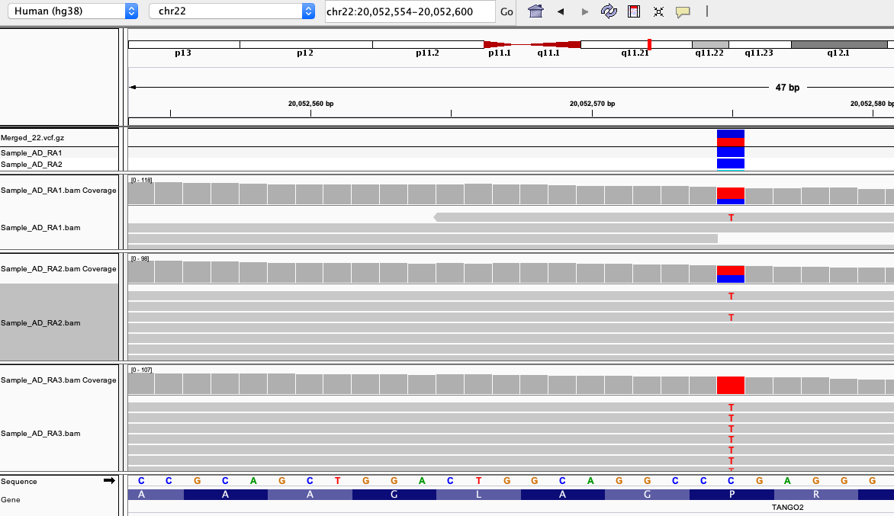
\{
IGV: Load VCF
VCF file is loaded as new tracks

Slide 39
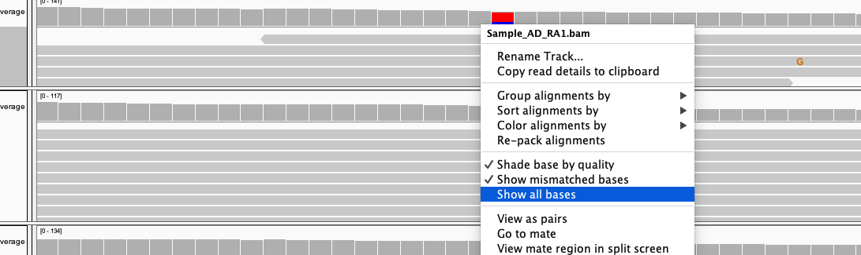
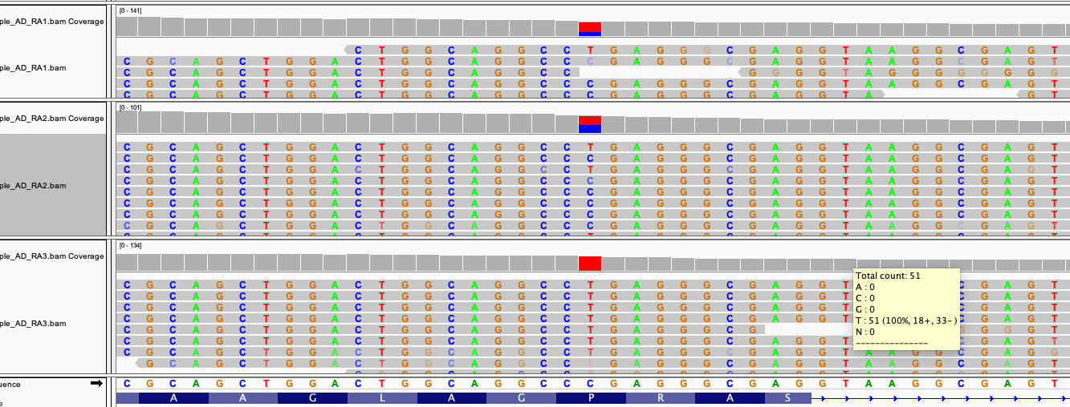
IGV: View All bases
Step1:

Slide 40
Hands on Visulization

Slide 41
Hands on Visulization
Step 1 : Connect to ood.hpc
Step 2 : Launch IGV Viewer
Step 3 : Load you the bams and VCf
Step 4 : Search for genes
Step 5 : Save session
Step 6 : Multiple Gene plot View

Slide 42
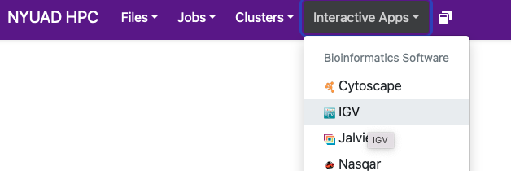
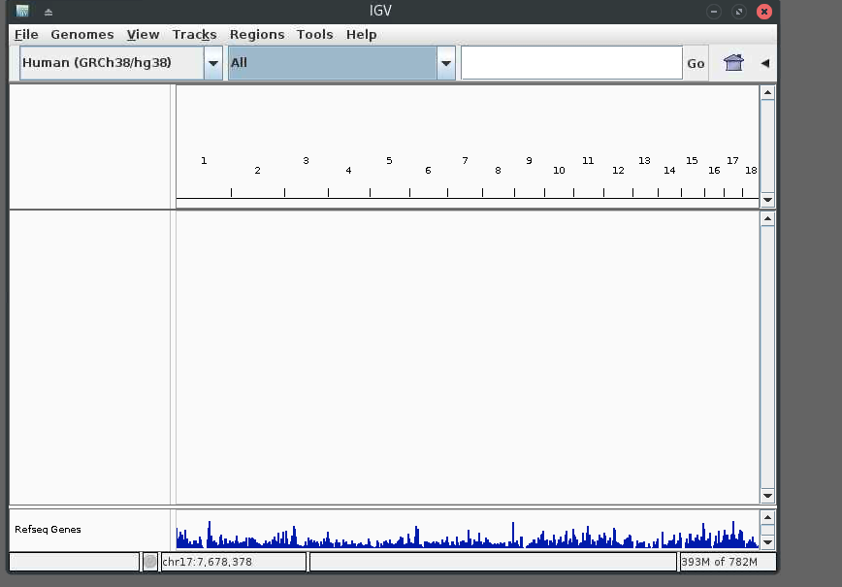
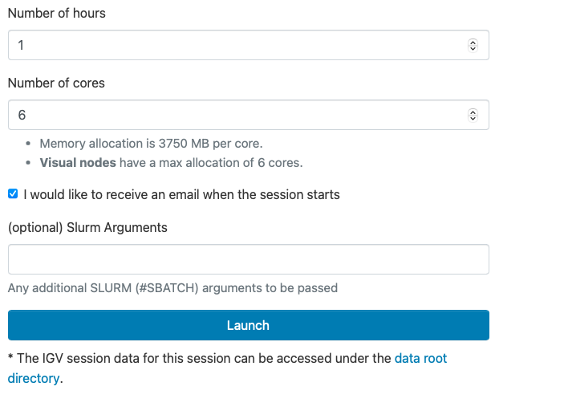
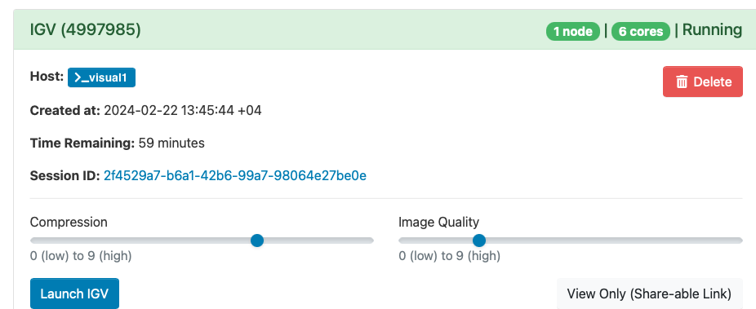
Hands on Visulization
Step 1: Connect to ood.hpc
Step 2:: Launch IGV Viewer

Slide 43
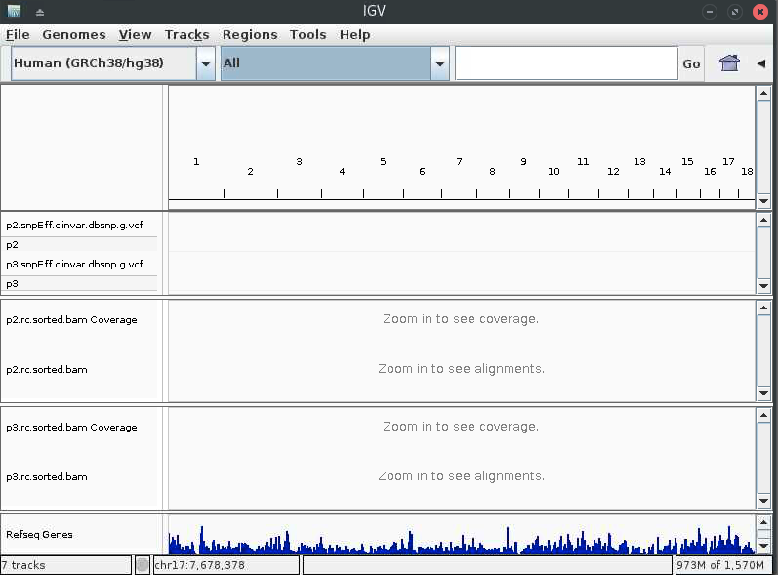
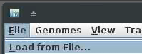
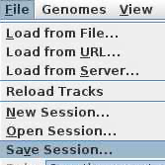
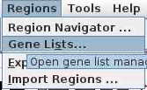
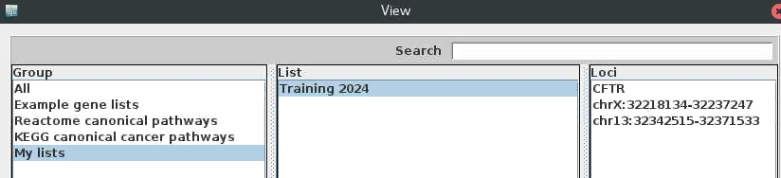
Hands on Visulization
Step 3: Load you the bam(s) and vcf(s)
Browse to your folder
P1/2/3.rc.sorted.bam
P1/2/3.snpEff.clinvar.dbsnp.g.vcf
Step 5 : Save session
Step 6 : Multiple Gene Plot

Slide 44
Hands on variant filtering

Slide 45
Hands on variant filtering
Task 1: Variant Filtering using SNPsift
Filter the data (P1/P2/P3) for
Consider only the variants with Total Depth with atleast 30 reads and
With quality of atleast 30 and
With Variant putative impact is high
Task 2: Visualization
Identify the Genes/Variants and Plot them in the IGV for all the three Sample sets

Slide 46
Hands on variant filtering
Filter the 3 data (P1,P2P3) for
Consider only the variants with Total Depth with atleast 30 reads and
With quality of atleast 30 and
With Variant putative impact is high
cat p1.snpEff.clinvar.dbsnp.g.vcf | SnpSift filter "( (DP >= 30) && (QUAL >= 30 )
&& (ANN[*].IMPACT has 'HIGH'))" > filtered.vcf

Slide 47
Interpretation of variant

Slide 48
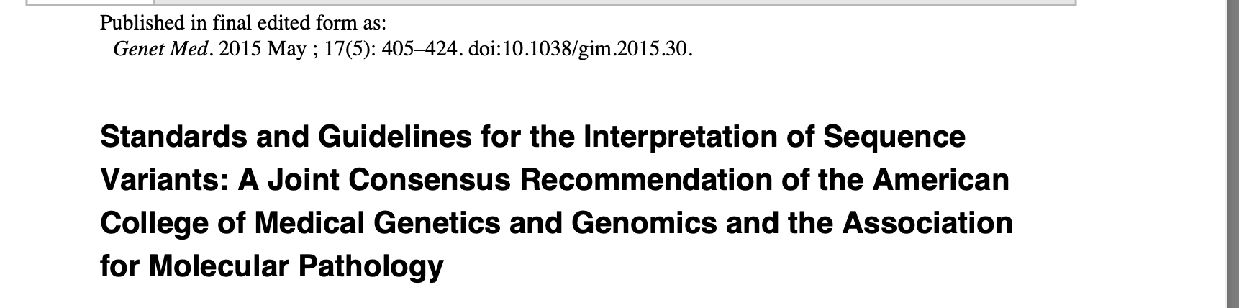
Interpretation of variant
https://www.ncbi.nlm.nih.gov/pmc/articles/PMC4544753/pdf/nihms697486.pdf

Slide 49
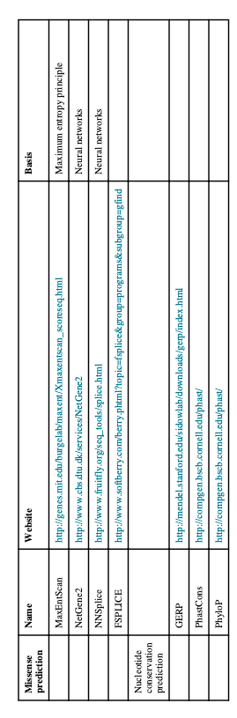
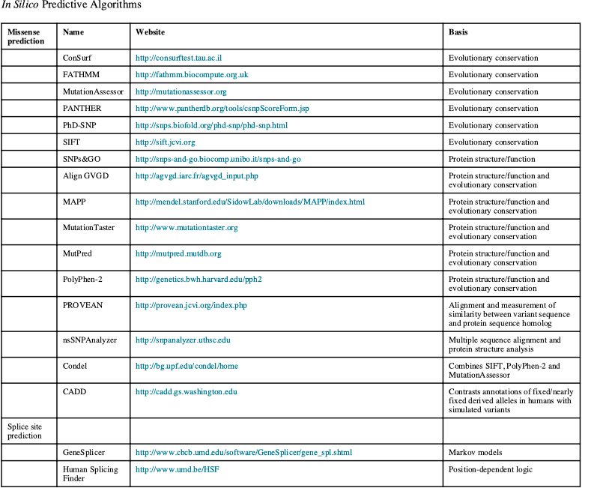
Interpretation of variant
Minimum 3 Tools should having matching output to confirm the effect in a clinical settings

Slide 50
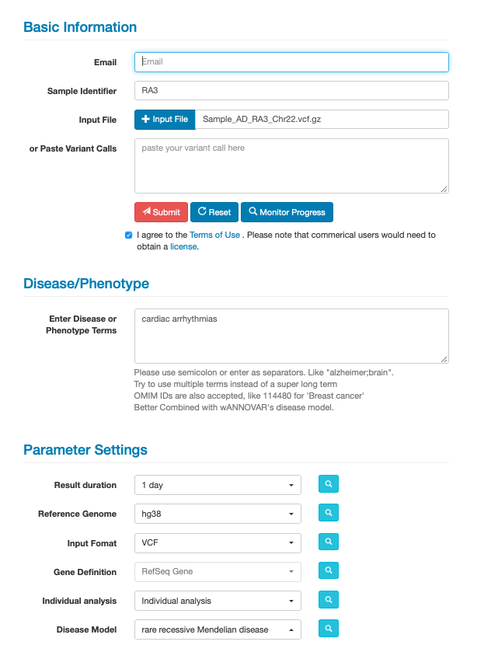

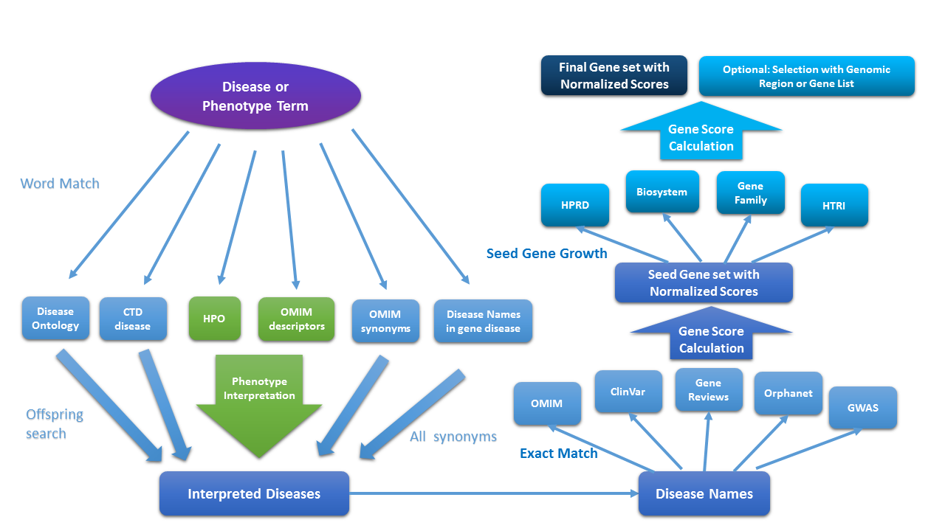
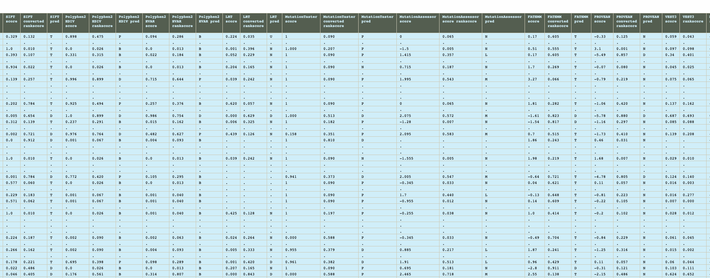

VCF Annotation: wANNOVAR
http://wannovar.wglab.org
anemi
anemia.vcf
http://phenolyzer.wglab.org
Phenotype Based Gene Analyzer, a tool focusing on discovering genes based on user-specific disease/phenotype terms
Annotation & Predictions

Slide 51
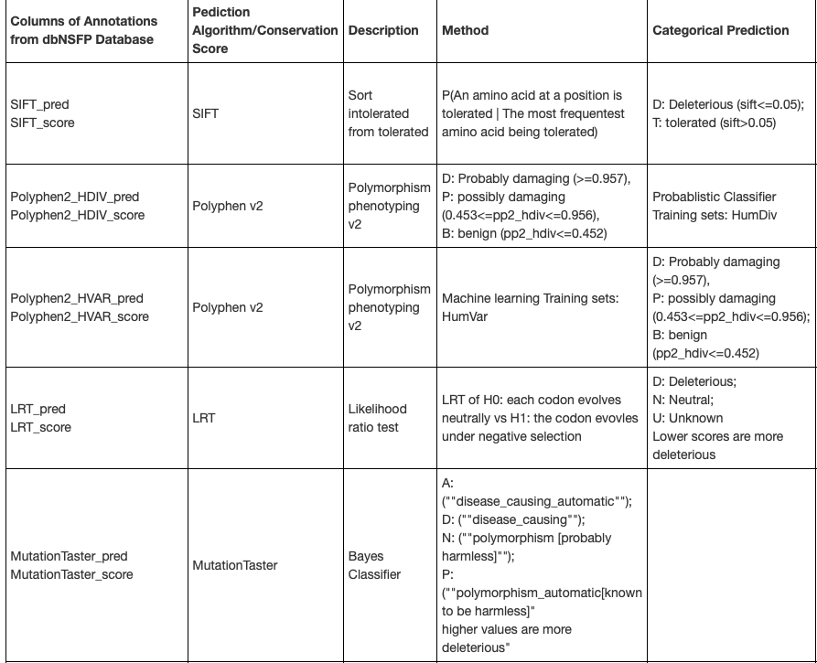
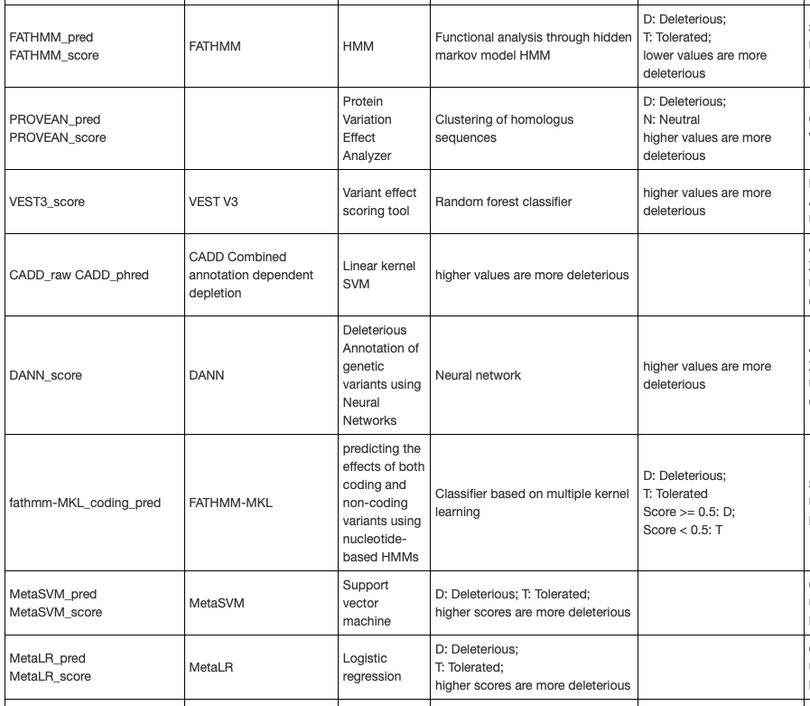
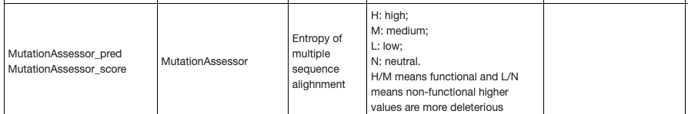
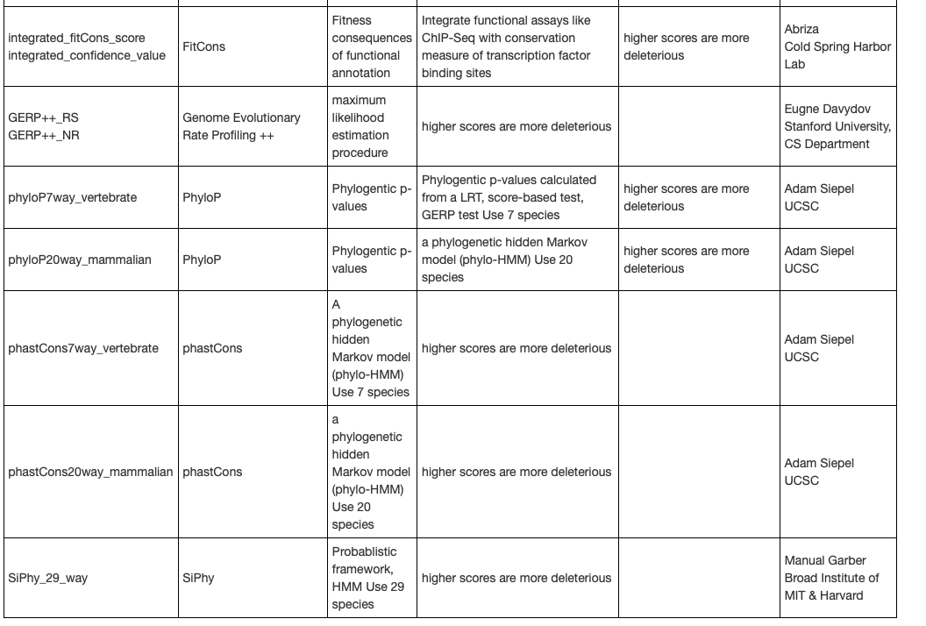
VCF Annotation: wANNOVAR
More info : https://brb.nci.nih.gov/seqtools/colexpanno.html

Slide 52
Lastly Reproducibility

Slide 53
Reproducibility
Tool(s) version : Module, docker, singularity
Pipeline workflow: BioSAILs, Snakemake,Nextflow
Single OS environment
Documentation: R markdown ,Github

Slide 54
Thank you & Any questions ?

